Slide 1
Comparing New York and Toronto’s Most Popular Venues

Slide 2
Background Context
Given their close proximity, examining the most popular venues in both New York City and Toronto may provide insight into how much a nation’s culture influences the success of a business.
Examining the venues may also provide insight into what sections of the cities a business could be most successful in.
This information could prove useful for potential business owners looking to open a new venue in either of the cities.

Slide 3
Gathering the data
Data for New York City will be gathered from https://cocl.us/new_york_dataset and placed into a dataframe to run through Foursquare. The venue data will then be grouped and clustered using k-means.
Toronto’s data will be scraped from https://en.wikipedia.org/wiki/List_of_postal_codes_of_Canada:_M and then combined with the latitude and longitude from https://cocl.us/Geospatial_data in order to run it through Foursquare and cluster it with k-means as well.

Slide 4
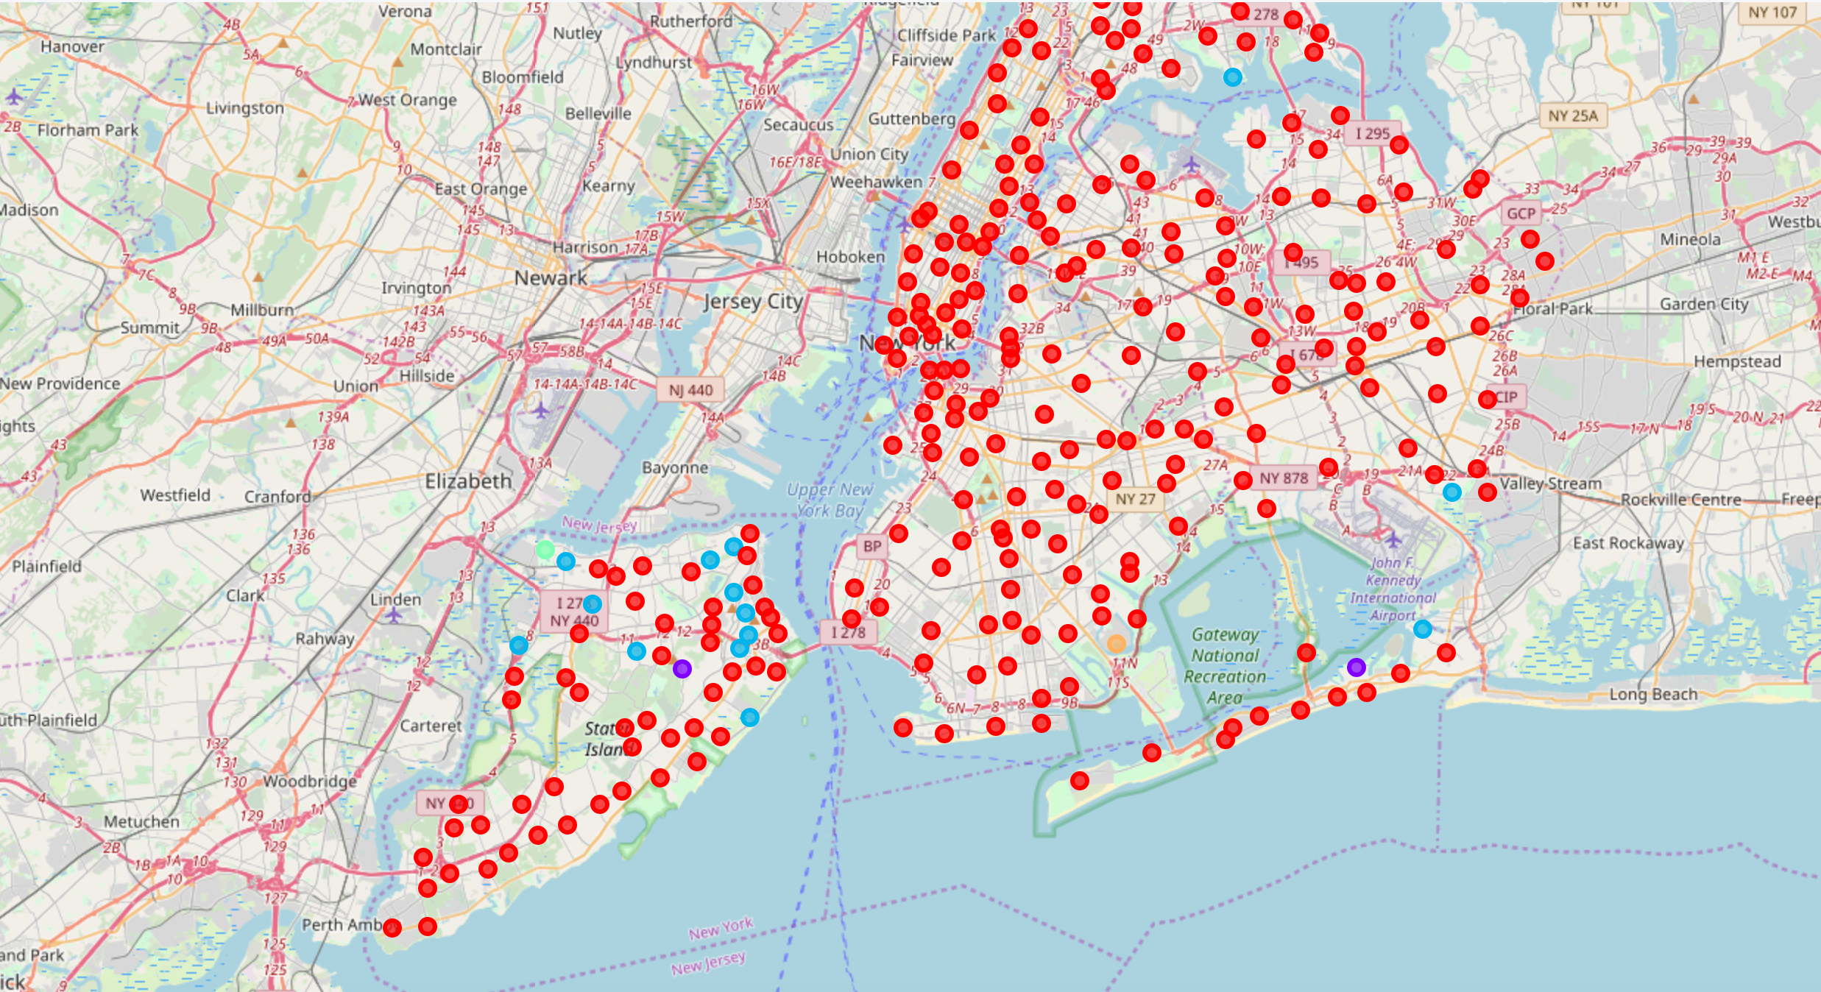
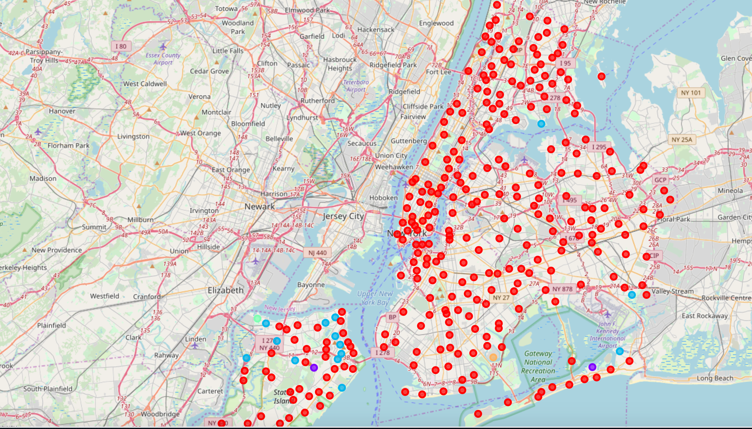
Map of the Clustered Data for New York
Cluster 0 = Red
Cluster 1 = Purple
Cluster 2 = Blue
Cluster 3 = Green
Cluster 4 = Orange

Slide 5
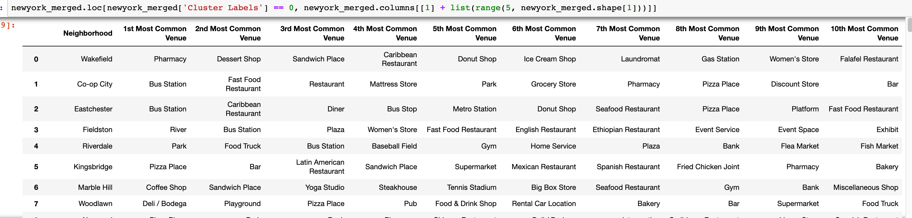
Clustered Data for New York

Slide 6
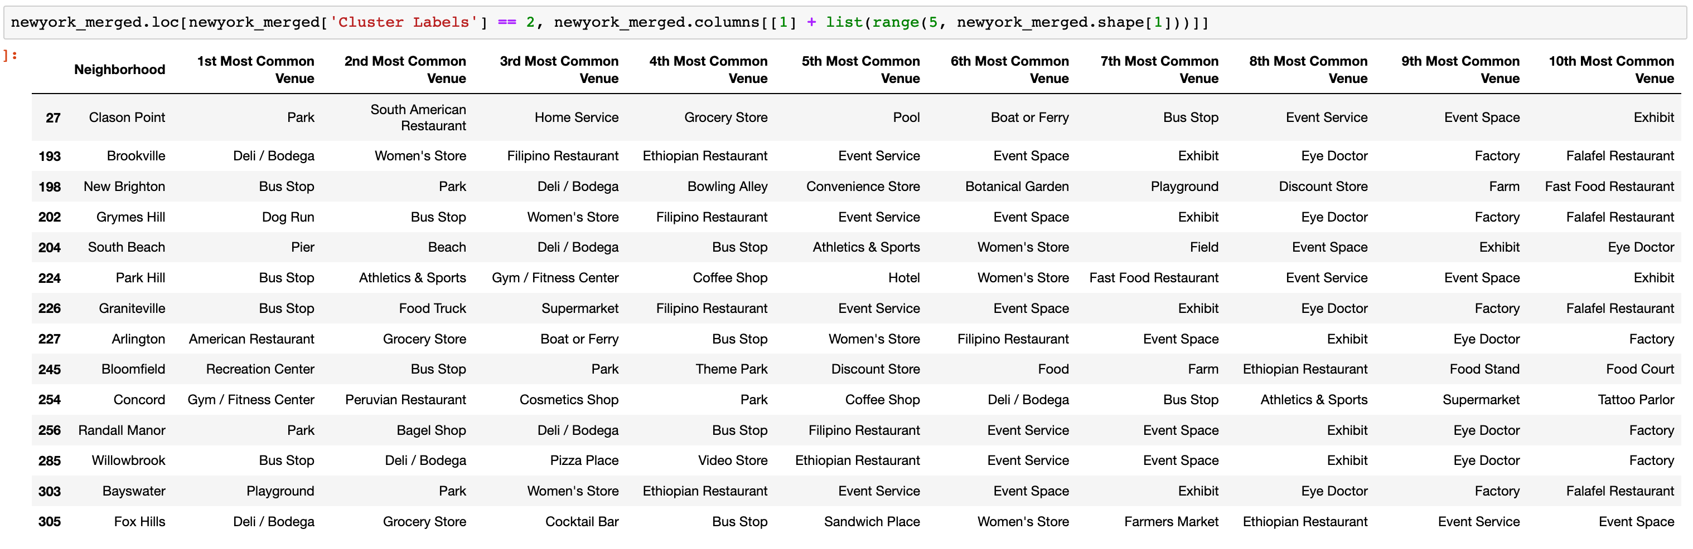
Clustered Data for New York Cont.

Slide 7
Clustered Data for New York Cont.

Slide 8
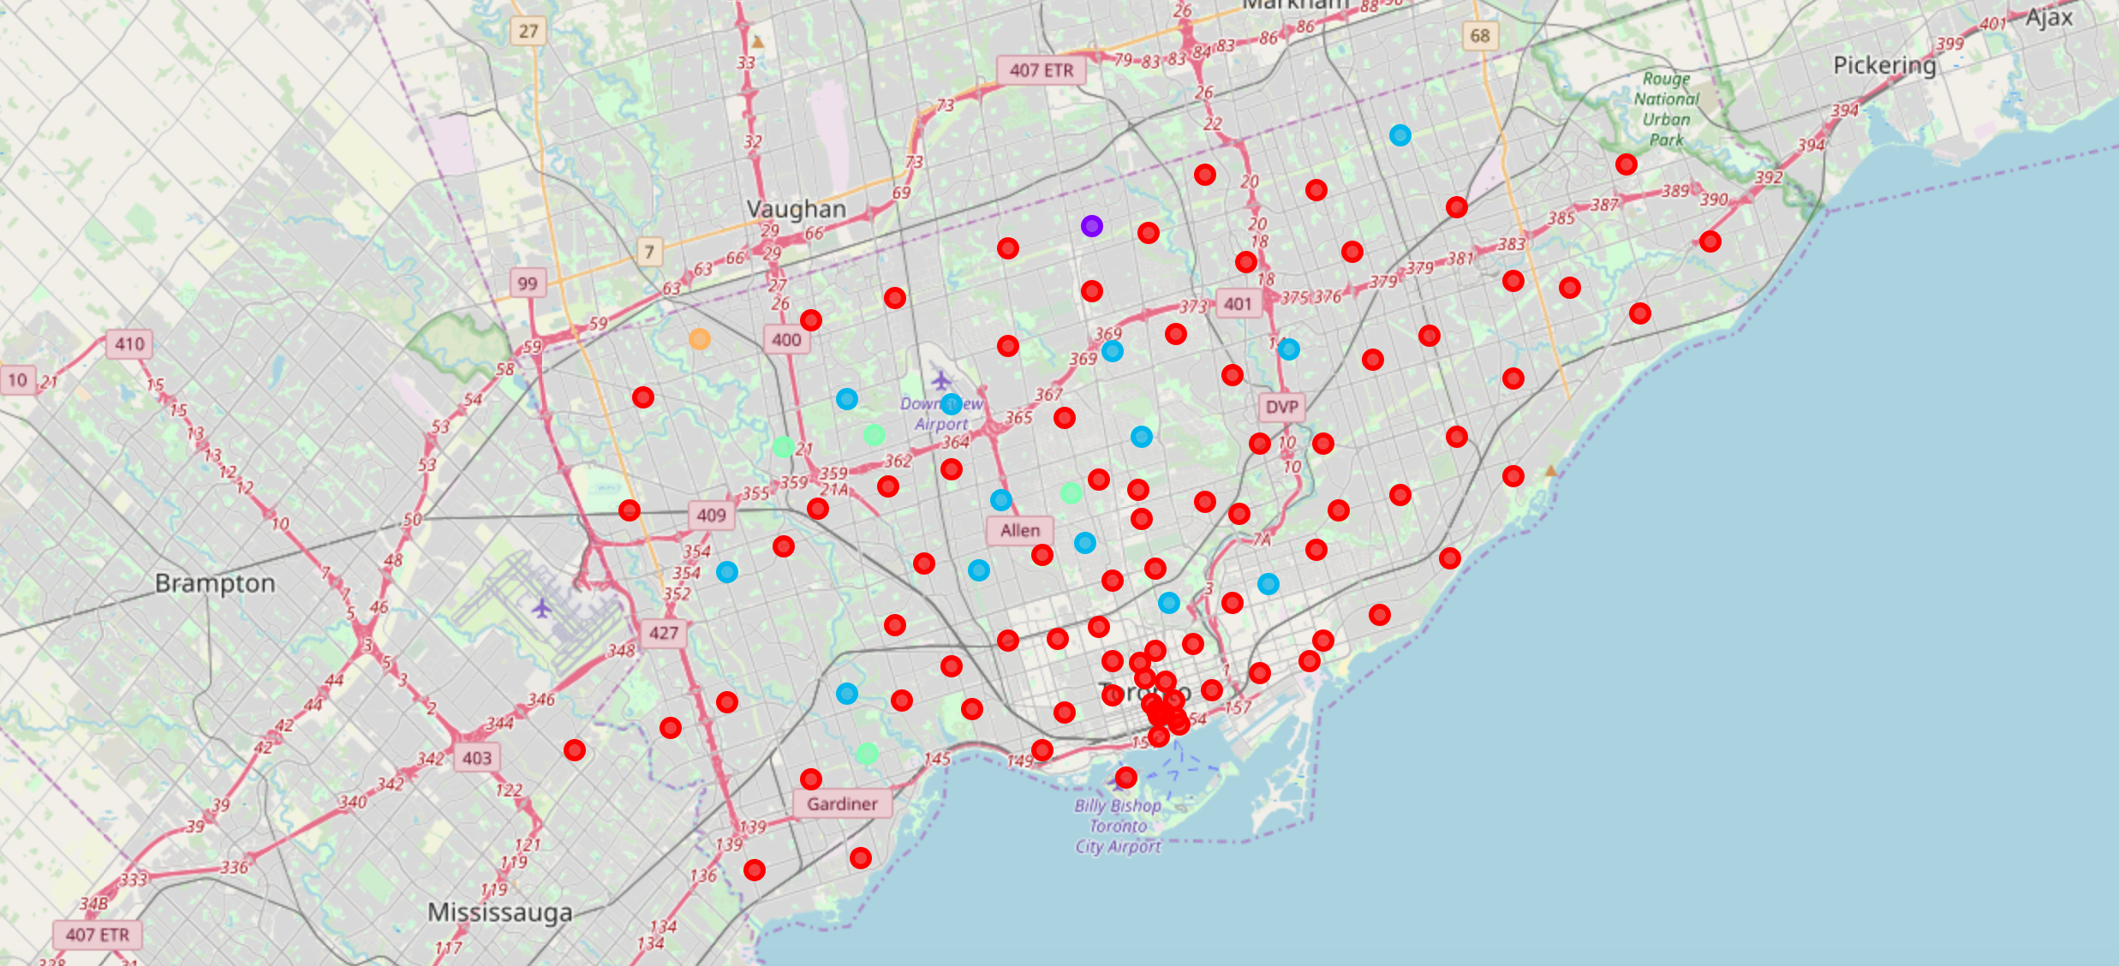
Clustered Data for Toronto
Cluster 0 = Red
Cluster 1 = Purple
Cluster 2 = Blue
Cluster 3 = Green
Cluster 4 = Orange

Slide 9
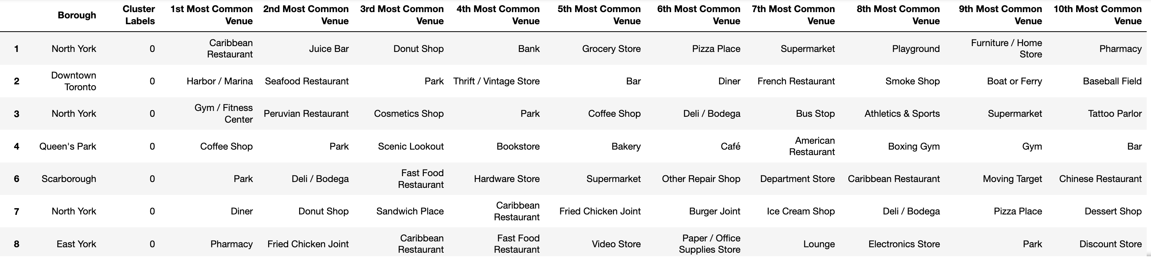
Clustered Data for Toronto

Slide 10
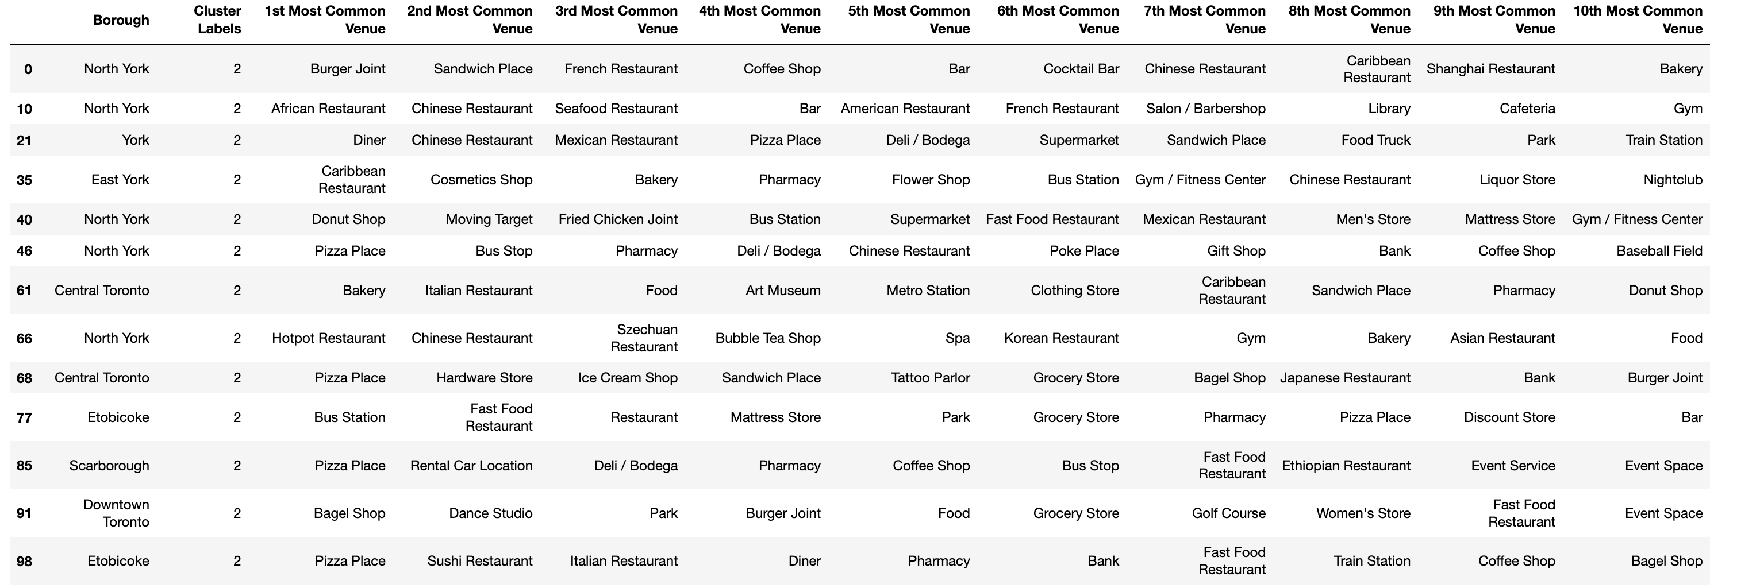
Clustered Data for Toronto Cont.

Slide 11
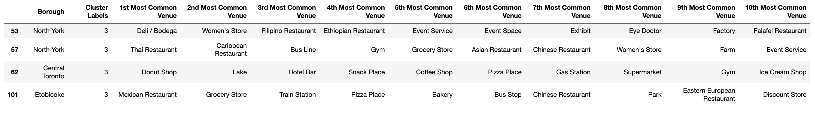
Clustered Data for Toronto Cont.

Slide 12
Discussion and Conclusions
Both cities appear to lean favorably towards pizza places and foreign restaurants. Bars and donut shops also appear to thrive in the central part of New York.
Smaller venues like parks and bus stations seem to be more popular in the outer neighborhoods of Toronto and New York.
The two cities appear to have a similar overlap in what venues are most popular, with both sharing similar venues in both the inner and outer sections of the city.
A respective business owner would likely have success with bringing their national cuisine into the central park of either city, and a pizza place would also thrive in a similar fashion.

